Slide 1
Graph Coloring
图的着色

Slide 2
four colors
Conjecture - 四色猜想
Four colors are always enough to color any map drawn on a plane
  This conjecture was proved to be true in 1976 with the aid of computer computations performed on almost 2,000 configurations of graphs. There is still no proof known that does not depend on computer checking.
School of Computer Science, BUPT

Slide 3
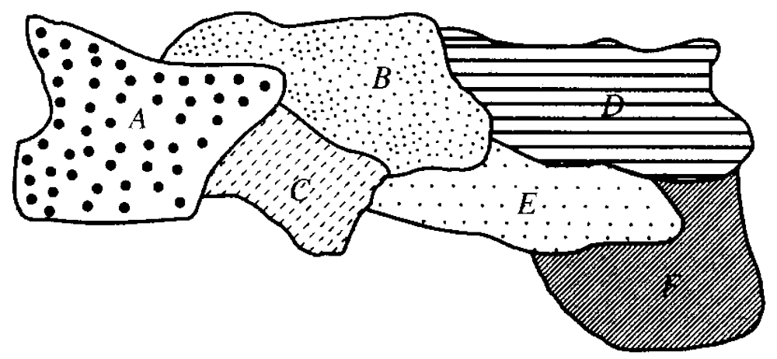
map-coloring problem
Of the many problems that can be viewed as graph-coloring problems, one of the oldest is the map-coloring problem.(地图着色问题)
School of Computer Science, BUPT

Slide 4
Coloring graphs
Suppose that G = (V, E, γ) is a graph with no multiple edges, and C = {c₁, c₂, …, c_{n}} is any set of n “colors”.
Any function f: V → C is called a coloring of the graph G using n colors (or using the colors of C).
  For each vertex v, f(v) is the color of v.
School of Computer Science, BUPT

Slide 5
χ(G)
A coloring is proper (合适的) if any two adjacent vertices v and u have different colors.
The smallest number of colors needed to produce a proper coloring of a graph G is called the chromatic number of G(G的着色数), denoted by χ(G).
School of Computer Science, BUPT

Slide 6
Example
χ(G) = 3
School of Computer Science, BUPT

Slide 7
Coloring vertex or edge?
Given a map M, construct a graph G_{M}
  Vertex u ↔ region R_{u}
  Edge (u, v) ↔ regions R_{u} and R_{v} share a common boundary.
School of Computer Science, BUPT

Slide 8
Appel-Haken Four-Color Theorem [1976]
The vertices of any planar graph can be 4-colored in such a way that no two adjacent vertices receive the same color.
School of Computer Science, BUPT

Slide 9
Five Color Theorem
Any planar graph can be colored with five colors.
School of Computer Science, BUPT

Slide 10
Lemma
Every Planar Graph Contains a Node of Degree ≤ 5
Proof
  If every node has degree at least 6, then the number of edges would be 3n, which would contradict our upper bound of 3n-6 edges in an n-node planar graph.
School of Computer Science, BUPT

Slide 11
Proof of 5-color theorem
Let G be a node-minimal counter-example to the theorem, i.e., a planar graph that requires 6 colors.
By Lemma, G must have a node q with degree ≤ 5. Let the nodes adjacent to q be named v₁, v₂, v₃, v₄, and v₅.
School of Computer Science, BUPT

Slide 12
Proof of 5-color theorem
v₁, v₂, v₃, v₄, v₅ can’t form a K₅
Some two neighbors v_{a}, and v_{b} of q must not have an edge between them
v_{b}
v_{a}
School of Computer Science, BUPT

Slide 13
Edge Contraction
v_{b}
Contract the edges <q, v_{a}> and <q,v_{b}> of G to obtain a planar graph G’.
G’ is 5 colorable since it has fewer nodes than G.
v_{a}
v_{a}, v_{b}, and q become a single node α in G’
School of Computer Science, BUPT

Slide 14
Using G’ to 5-color G.
v_{b}
Color v_{a} and v_{b} the same as α. Color each node besides q, as it is colored in G’.
Color q whatever color is not used on its 5 neighbors.
  Q.E.D.
v_{a}
v_{a}, v_{b}, and q become a single node α in G’
School of Computer Science, BUPT

Slide 15
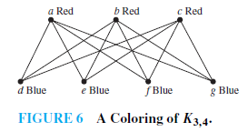
Example
What is the chromatic number of the complete bipartite graph k_{m,n} where m and n are positive integers?
School of Computer Science, BUPT

Slide 16
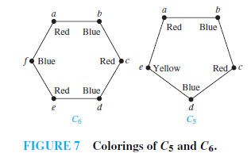
Example
What is the chromatic number of the graph C_{n}?
School of Computer Science, BUPT

Slide 17
Graph-coloring
Graph-coloring problems also arise from counting problems.
School of Computer Science, BUPT

Slide 18
Example
Fifteen different foods are to be held in refrigerated compartments within the same refrigerator.
Construct a graph G as follows.
  Construct one vertex for each food and connect two with an edge if they must be kept in separate compartments in the refrigerator.
  Then χ(G) is the smallest number of separate containers needed to store the 15 foods properly.
School of Computer Science, BUPT

Slide 19
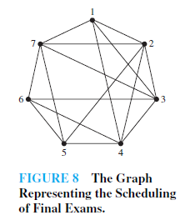
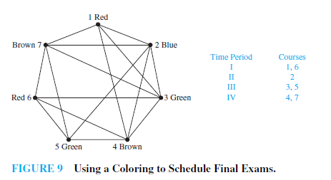
Applications of graph colorings
How can the final exams at a university be scheduled so that no student has two exams at the same time?
School of Computer Science, BUPT

Slide 20
Applications of graph colorings
Frequency assignments
  Television channels 2 through 13 are assigned to stations in North America so that no two stations within 150 miles can operate on the same channel. How can the assignment of channels be modeled by graph coloring?
School of Computer Science, BUPT

Slide 21
Applications of graph colorings
For a given loop, how many index registers are needed?
School of Computer Science, BUPT

Slide 22
Another problem
Computing the total number of different proper colorings of a graph G using a set {c_{l} ,c₂ , . . . , c_{n}} of colors.
School of Computer Science, BUPT

Slide 23
Chromatic Polynomials
If G is a graph and n ≥ 0 is an integer, let P_{G}(n) be the number of ways to color G properly using n or fewer colors.
P_{G} is called the chromatic polynomial(着色多项式) of G.
School of Computer Science, BUPT

Slide 24
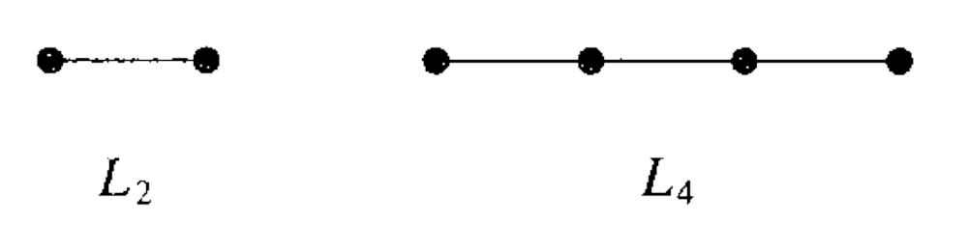
Linear graph L₄
Suppose we have x colors
  P_{L4} = x(x-1)³
  P_{L4}(0) = 0
  P_{L4}(1) = 0
  P_{L4}(2) = 2
  P_{L4}(3) = 24
  So, χ(L₄) = 2
School of Computer Science, BUPT

Slide 25
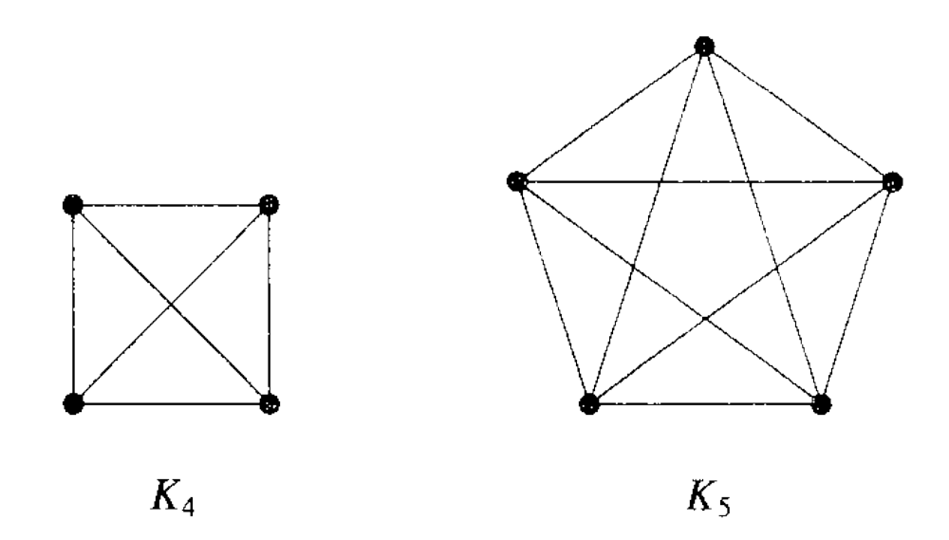
Complete graph K_{n}
Suppose we have x colors, if x < n, no proper coloring is possible. So let x ≥ n
  P_{K5} (x) = x(x-1) (x-2) … (x-n+1)
  P_{K5}(5) = 5!
  So, χ(K₅) = 5
School of Computer Science, BUPT

Slide 26
Theorem 1
If G is a disconnected graph with components G₁, G₂, . . . . G_{m}, then P_{G}(x) is the product of the chromatic polynomials for each component
  P_{G}(x) = P_{G1}(x) P_{G2}(x) . . . P_{Gm}(x)
School of Computer Science, BUPT

Slide 27
Subgraph
One of the most important subgraphs is the one that arises by deleting one edge and no vertices.
If G = (V, E, γ) is a graph and e∈E, then we denote by G_{e} the subgraph obtained by omitting the edge e from E and keeping all vertices.
School of Computer Science, BUPT

Slide 28
Quotient graph（商图）
Suppose that G = (V, E, γ) is a graph without multiple edges between the same vertices and that R is an equivalence relation on the set V. Construct the quotient graph G^{R} as follow:
  The vertices of G^{R} are the equivalence classes of V produced by R. If [v] and [w] are the equivalence classes of vertices v and w of G, then there is an edge in G^{R} from [v] to [w] if and only if some vertex in [v] is connected to some vertex in [w] in the graph G.
School of Computer Science, BUPT

Slide 29
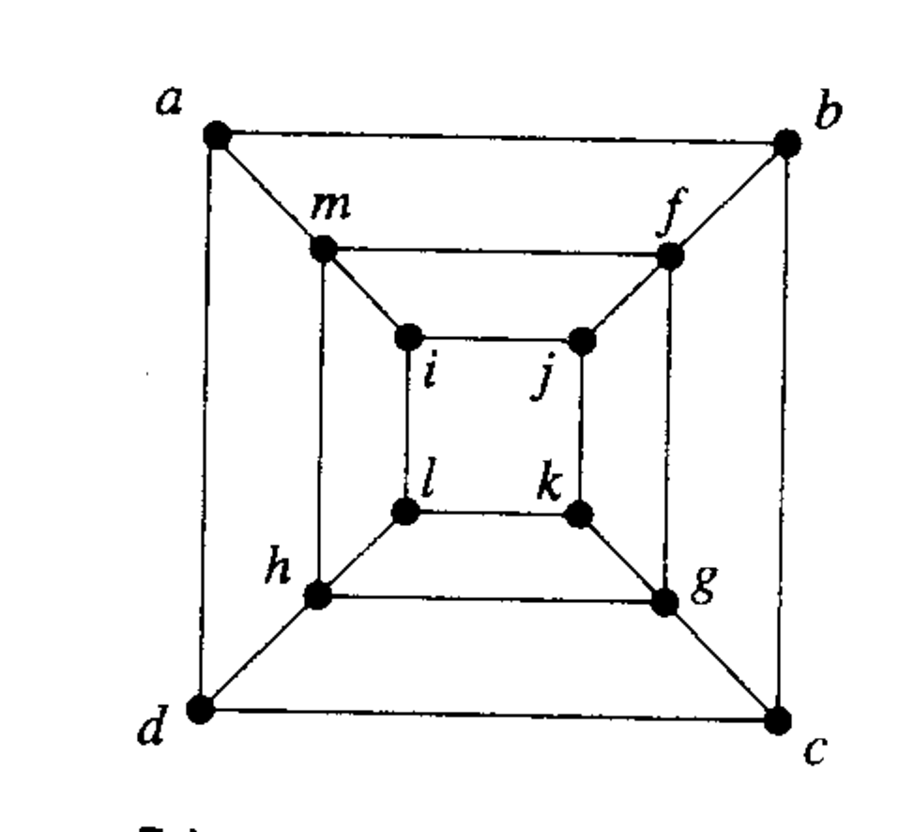
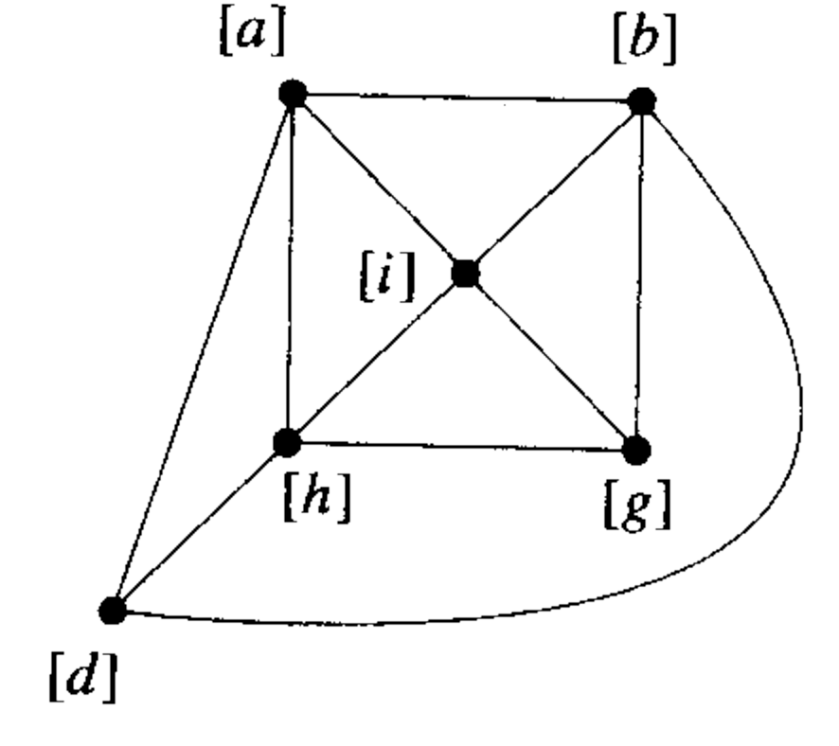
Example
R = {{i,j,k,l},{a,m},{f,b,c},{d},{g},{h}}
School of Computer Science, BUPT

Slide 30
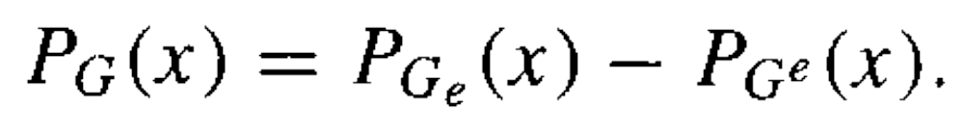
Theorem 2
Let G = (V, E, γ) be a graph with no multiple edges, and let e ∈ E, say e = {a, b}.
  G_{e} : subgraph of G obtained by deleting e,
  G^{e} : the quotient graph of G obtained by merging the end points of e.
Then with x colors:
School of Computer Science, BUPT

Slide 31
Proof
Consider all the proper colorings of G_{e}
  a and b have different colors
  a and b have the same color
A coloring of the first type is also a proper coloring for G
  since a and b are connected in G, and this coloring gives them different colors.
School of Computer Science, BUPT

Slide 32
Proof
  a and b have different colors
  a and b have the same color
A coloring of G_{e} of the second type corresponds to a proper coloring of G^{e}.
  In fact, since a and b are combined in G^{e}, they must have the same color there. All other vertices of G_{e} have the same connections as in G. Thus
  P_{Ge}(x) = P_{G}(x) + P_{G}^{e}(x)
    or
  P_{G} (x) = P_{Ge}(x) − P_{G}^{e}(x)
    Q.E.D
School of Computer Science, BUPT

Slide 33
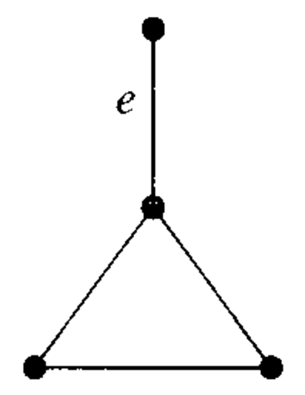
Example 8
Let us compute P_{G}(x) for the graph G using the edge e.
Then G^{e} is K₃ and G^{e} has two components, one being a single point and the other being K₃.
School of Computer Science, BUPT

Slide 34
Example 8
By Theorem l
  P_{Ge}(x) =x(x(x − 1)(x − 2)) =x²(x − 1)(x − 2)
  P_{G}^{e}(x) =x(x − 1)(x − 2)
By Theorem 2,
  P_{G} (x) = x²(x − 1)(x − 2) − x(x − 1)(x − 2)
  = x (x − 1)²(x − 2)
So, χ(G) = 3
School of Computer Science, BUPT

Slide 35
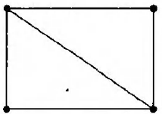
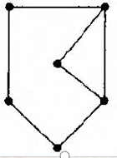
Example
Find the chromatic polynomial(着色多项式) P_{G} for the given graph and use P_{G} to find χ(G) .
x(x-1)(x-2)²
x(x-1)(x-2)²(x²-2x+2)

Slide 36
homework
§10.8
  10, 16, 20, 23, 34
School of Computer Science, BUPT

